Slide 1
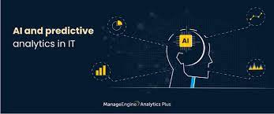
Ai-Driven exploration and predication of combanies registration trends with registrar of companies(ROC)
By
Agnes godwin.M
Mohammed fahim.A
Najeeb.S
Abubacker Siddiq.M
Kamil hisham.N
Ahamed alphan.N

Slide 2
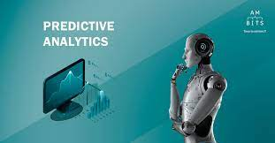
INDRODUCTION
Artificial intelligence (AI) has captured the attention of business leaders, scientists, and engineers worldwide. Across industries leaders are seeking ways to create value through machine learning and other frontier technologies.
Companies like Facebook, Amazon, Google, and Alibaba have made commercial strides into AI—from smart bots to facial recognition to semantic analysis. Others like GE and If framed correctly, the opportunities for smart applications abound.
For example, there’s potential to mitigate climate change via autonomous transportation, or develop better preventative healthcare through predictive modeling.
Siemens are dedicating a large share of R&D to the AI-fueled industrial This program is designed to teach the management and application of artificial intelligence in the global business world. Internet.

Slide 3

Ai for predictive analysis
Predictive analytics is the process of using data, statistical methods, and machine learning to forecast future outcomes and trends. It can help you optimize your businreduce risks, and enhance customer satisfaction.
In this article, you will learn how you can use artificial intelligence (AI) for predictive analytics, and what are some of the benefits and challenges of this approach.
ess dAI is the branch of computer science that aims to create systems that can perform tasks that normally require human intelligence, such as reasoning, learning, and My observations over the years has taught me that there is no one-size-fits-all approach to AI for predictive analytics.
For different kinds of predictive tasks, different AI techniques are more appropriate. Simpler machine learning models, such as decision trees or logistic regressionproblem-solving.ecisions,

Slide 4
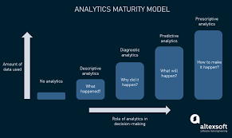
The challeges for using predictive analysis
Using AI for predictive analytics presents some challenges that must be addressed, such as data quality and availability, ethical and legal issues, and skills and resources. To ensure accuracy, completeness, relevancy, and consistency of data, you need access to a large variety of data sources and formats.
Ethical and legal questions, such as privacy, security, fairness, accountability, and transparency must be taken into consideration when using AI. Additionally, a team of experts and professionals is needed to handle the technical and business aspects of AI projects.
Furthermore, investing in the necessary tools and infrastructure is essential for supporting your AI initiatives.

Slide 5
Data quality
Data Quality: AI models require clean, relevant data. Poor data can lead to inaccurate predictions. Overfitting: Models might perform exceptionally on training data but poorly on new data if they're too complex.
Interpretability: Some AI models, like deep neural networks, can be "black boxes," making it hard to understand their decisions.
Computational Costs: Training complex models, especially deep learning ones, can be resource-intensive.
Bias: If historical data contains biases, AI models can perpetuate or amplify them. Data Privacy: Using personal data raises privacy concerns and regulatory issues.
Model Drift: Over time, models can become less accurate if not updated with fresh data.

Slide 6
Data collection
Gather relevant data from various sources. Data Preprocessing: Cleanse data by handling missing values and outliers. Feature Engineering: Select or create predictive features. Model Selection: Choose ML algorithms based on problem type. Training: Train models using historical data. Hyperparameter Tuning: Optimize model settings. Cross-Validation: Assess model robustness. Evaluation: Use metrics like MAE, RMSE, and Accuracy. Deployment: Deploy models for real-time predictions. Monitoring: Continuously monitor and retrain models. AI-driven predictive analytics enhances decision-making in various industries.
Like
2
Gather relevant data from various sources. Data Preprocessing: Cleanse data by handling missing values and outliers. Feature Engineering: Select or create predictive features. Model Selection: Choose ML algorithms based on problem type. Training: Train models using historical data. Hyperparameter Tuning: Optimize model settings. Cross-Validation: Assess model robustness. Evaluation: Use metrics like MAE, RMSE, and Accuracy. Deployment: Deploy models for real-time predictions. Monitoring: Continuously monitor and retrain models. AI-driven predictive analytics enhances decision-making in various industries.
Like
2
Gather relevant data from various sources. Data Preprocessing: Cleanse data by Feature Engineering: Select or create predictive features.
handlingModel Selection:
Choose ML algorithms based onTraining:
Train models using historical data. Hyperparameter Tuning: Optimize model settings.
Cross-Validation: Assess model robustness. prEvaluation: Use metrics like MAE, RMSE, and Accuracy.
Deployment: Deploy models for real-time predictions. oblem type. missing values and outliers.

Slide 7
Benefits or Advantages:
AI for predictive analytics can bring many benefits to your business, such as increased accuracy and reliability due to its ability to process more data and variables than traditional methods.
Additionally, AI can automate and streamline workflows, providing faster and more actionable results.
This can save time and resources, and enable focus on core business activities. Furthermore, AI can uncover new opportunities and insights that you might not have discovered otherwise, helping you create new products, services, and solutions.
This can give you an edge over competitors, and increase customer loyalty and satisfaction.

Slide 8

Disadvanges:
It is often poorly distinguished from predictive analytics, which makes defining best practice more challenging.
Overconfidence in machine learning's predictive capabilities can lead to people being swayed to follow its advice, regardless of whether or not it is correct

